Slide 1

Pitching
Course ICT-Entrepreneurship
Prof. Sjaak Brinkkemper
Dr. Gerard Wagenaar

Slide 2

Disrupt or Die
In the elevator ...

Slide 3



You should have several pitches at hand
1 sentence
We’re like Tinder for travelling
3 sentences
Elevator pitch
1 minute
Include achievements
10 minutes
Investor pitch

Slide 4
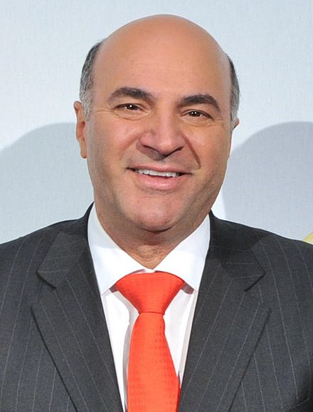
Tip #1 – Know your audience
Get in their minds
There is strong competition
Seen the idea before
The market is “competent” at finding new ideas already
You do not have magical abilities
Odds of success about 100 to 1
Adoption is highly questionable
Unbabel

Slide 5

Tip #2 – Design the structure
Knowing the structure is THE METHOD to achieve reliable results!
Examples
The Movies: A script is structure
The typical News Story
Your Pitch!
Pitching is NOT for “Cowboys”
Good Structure creates understanding and positive emotion.
Failed structure creates frustration, resentment, rejection.
Structure embodies your story

Slide 6
Tip #2 – Design the structure
Notice! The embedded story:
setting
conflict
struggle
victory
Happily every after
(creates good emotion)
Insert Headlines Here!
Overview
Problem
Solution
Market and how to get it
Business Model
Ask
Tell of “old failed solutions”, transition to your discovery of the REAL solution.
“Secret sauce” (like nobody else)
HigherMe

Slide 7

Tip #3 – Tell a story
4 Key leverage points - Your inspiration to solve - Your solution discovery - Your traction triumph - Your gritty problem solving tactics
Use some “actualities” instead of fictions
3 images in every story: problem appears, conflict ensues (the fight), victory image of happiness
ALWAYS: Put the story in context by explaining the meaning for the pitch.

Slide 8
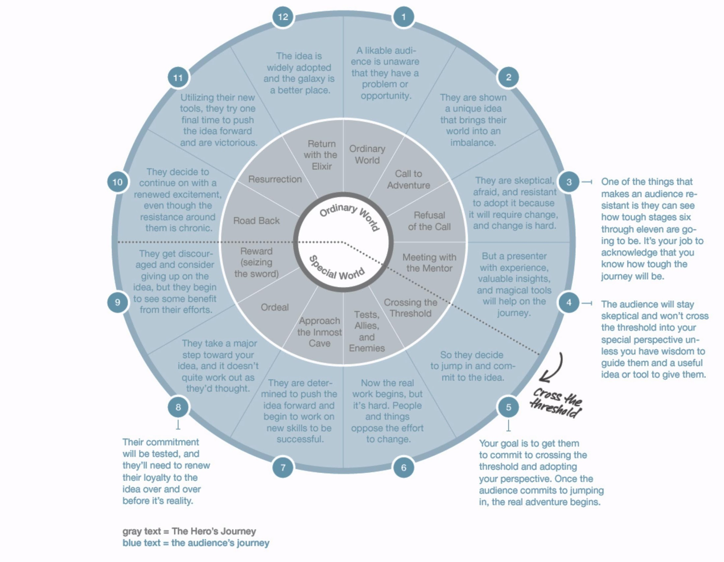

Tip #3 – Tell a story
The audience’s journey

Slide 9
Tip #4 – Prove the hypothesis?
Unspoken hypothesis of every pitch
“This business opportunity justifies investment”
product its price
plan your effort
… …
Business Model +
Evidence: Market
Evidence: Team
Evidence: Tech
Evidence: Traction

Slide 10

Tip #5 – Break habits and mix it up
Everybody has a “persona” and can get stereotyped – fight it.
If you talk fast → Insert slow parts
If you are always intense → Insert some kind of joke or humor
If you get wound up about the technology → make a joke about it
Be Human and find ways to relate to the
listeners
RESULT: You’re viewed as a better leader, better collaborator, more trustworthy and more likeable

Slide 11









Tip #6 – Feature your HEADLINES!
What gets you to the fabled “WOW”? Put it early in the structure!
Traction
Tech Prowess
Truly rock star team
Revenue
Endorsements (name dropping)
Media coverage
IMPLICATION: If you have none of these, GO GET SOME!
KuhCoon

Slide 12
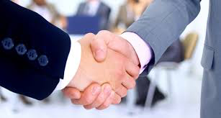
Tip #7 – Get a “use case”
Who, specifically, uses the product?
In what concrete situation?
By what “modality” do they use it?
How easy and different is the experience?
What’s the result?
Who gets paid by whom?
SuperHost

Slide 13

Tip #Bonus – Talk like a 12 year old!
“I’ve fallen and I can’t get up!”
“We do Chicken Right”
“The Friendly Skies”
“Think Different”
“1000 songs in your pocket”
Beware of: Buzzwords, Business speak, over qualification, too much detail, etc, etc….
Sendwithus

Slide 14

Tip #Bonus – Master body language
Body language

